Slide 1


Device Code Phishing: When MFA Is Not Enough
Exploiting OAuth 2.0 RFC 8628 Device Authorization Grant
Presenter
Platform Identifiers
Timeline
Seyed Mehdi Sahafi Najafi Nejad
edX: seyyedmahdi-j2d0a3e | GitHub: seyyedmahdinajafi
Incident: March 2026 | Recorded: August 2026
CS50 Cybersecurity Final Project
Slide 1 / 11

Slide 2
Understanding RFC 8628
The OAuth 2.0 Device Authorization Grant specification designed for browserless and input-constrained environments.
Originally built to enable Smart TVs, IoT hardware, and CLI tools (e.g., Azure CLI) to obtain authorization using a secondary device with full browser capabilities.
RFC 8628 Architecture
Slide 2 / 11

Slide 3


Standard Flow vs Weaponized Threat
Legitimate RFC 8628 Flow
Weaponized Device Code Phishing
User-Initiated: The user requests authentication from a Smart TV or terminal tool (e.g., az login).
Attacker-Initiated: Threat actor executes background POST request to generate a device code pair.
Secondary Auth: User receives a 9-character code and completes login on their smartphone or PC browser.
Social Engineering: Victim is tricked into visiting official login.microsoft.com/devicelogin and entering code.
Expected Access: Tokens are returned directly to the initiating legitimate device for session setup.
Token Interception: Upon victim completion, tokens drop straight into the attacker's polling terminal.
Protocol Abuse Analysis
Slide 3 / 11

Slide 4








Anatomy of a Device Code Attack
Code Generation
Lure Delivery
Victim Auth + MFA
Token Exfiltration
Attacker sends POST to IdP endpoint using public client IDs (Office/Azure CLI) to request user_code & device_code.
Phishing message (email/Teams) tricks victim into approving access with the provided code on real IdP URL.
Victim authenticates on legitimate Microsoft domain and completes standard MFA prompt. Zero fake domains involved.
Attacker's daemon receives Access & Refresh tokens, hijacking session without ever capturing a password.
Attack Lifecycle
Slide 4 / 11

Slide 5









Why Traditional MFA Fails
100% Genuine Domain
MFA Completion
No Passwords Stolen
Victims type their credentials directly into login.microsoft.com. Secure Web Gateways and domain reputation filters see clean, trusted traffic.
The victim completes legitimate MFA for the attacker-initiated authentication request.
Skip credential harvesting entirely. The threat actor obtains OAuth Access & Refresh tokens directly via standard token endpoint polling.
Security Control Bypass Mechanisms
Slide 5 / 11

Slide 6

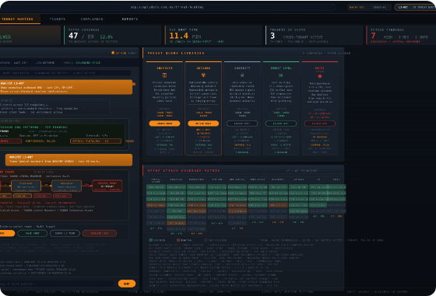
Incident Analysis: March 2026 Breach
EvilTokens Automation: Surge of automated PhaaS toolkits leveraging RFC 8628 to bypass FIDO2 MFA en masse.
First-Party Client Abuse: Exploited immutable public Microsoft client IDs (Azure CLI, PowerShell) impossible to revoke globally.
Persistent Access: Requested offline_access scope, yielding refresh tokens that survived password resets and basic session revocations.
Limited Traditional Detection: Because authentication occurs through legitimate identity infrastructure, traditional malware and domain-based detection may have limited visibility.
Case Study & Threat Intelligence
Slide 6 / 11

Slide 7
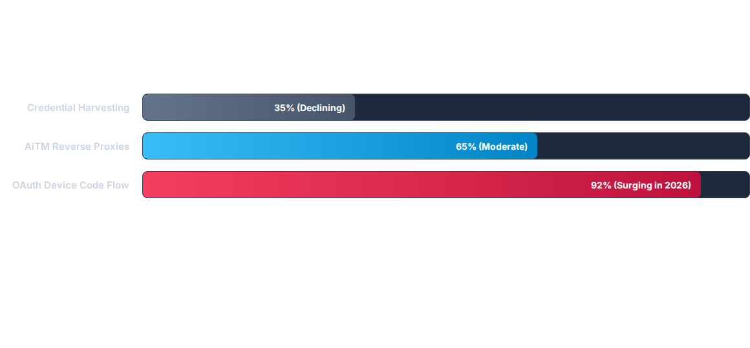
Identity Attack Vector Trends
Data indicates a 310% increase in OAuth Device Code Phishing across enterprise tenants between 2024 and 2026, driven by strict MFA enforcement neutralizing legacy phishing kits.
Threat Landscape Metrics
Slide 7 / 11

Slide 8
Attack Vector Comparison Matrix
Vector Attribute | Traditional Phishing | AiTM Proxy (Evilginx) | Device Code Phishing
Domain Hosted On | Spoofed / Typosquatted URL | Reverse Proxy Domain | Official login.microsoft.com
Captures Password? | Yes | Yes | No (Token Theft Only)
Bypasses MFA? | No | Yes | Yes (Pass-through)
Detection Level | Low (Easy to block) | Medium (Domain flags) | Extremely Difficult
Comparative Technical Analysis
Slide 8 / 11

Slide 9


Critical Severity Driver
Zero Malicious Artifacts to Scan
0%
Because the attacker relies entirely on Microsoft's native authorization endpoints, traditional email gateways, DNS inspection, and endpoint detection agents detect zero malicious links, binaries, or reverse proxy servers.
Malicious Infrastructure
"The ultimate stealth attack: forcing the victim to act as their own proxy directly on official identity infrastructure."
Evasion Capability
Slide 9 / 11

Slide 10
Defense & Mitigation Strategy
Conditional Access Policies (CAP): Explicitly block Device Code Flow in Entra ID / Okta for all non-administrative users or unmanaged devices.
Restrict OAuth App Consent: Disable user consent for apps requiring offline_access or high-privilege directory permissions.
Anomalous Token Monitoring: Query sign-in logs for non-interactive token refreshes originating from unexpected ASNs or impossible travel IPs.
User Security Training: Educate staff that device code prompts should never be entered unless actively initiating a login on a secondary device.
Remediation Roadmap
Slide 10 / 11

Slide 11

Questions?
Thank you for reviewing this final presentation.
CS50's Introduction to Cybersecurity
Final Project Submission
GitHub: seyyedmahdinajafi
edX: seyyedmahdi-j2d0a3e
CS50 Cybersecurity Final Project
Slide 11 / 11

Slide 12

Image Sources
https://www.simplydata.com.my/wp-content/uploads/2026/05/ai-threat-hunting-dashboard-2026-05-23.png
Source: www.simplydata.com.my

